Slide 1
Illuminate
- Kyle Bess

Slide 2
Game Overview
Working Titles
Theme
Intended Audience
Illuminate
Blind Faith
Cave Light
Adventure
Mystery
Exploration
Teenagers and up through adults
Anyone who likes to be challenged

Slide 3

Elevator Pitch
Celeste with no light

Slide 4
Features
Evolving mechanics :
Each level will have a new and unique mechanic that the player must adapt to in-order to pass through the level.
https://tinyurl.com/y8z3so5b
https://tinyurl.com/ychwd3kw

Slide 5
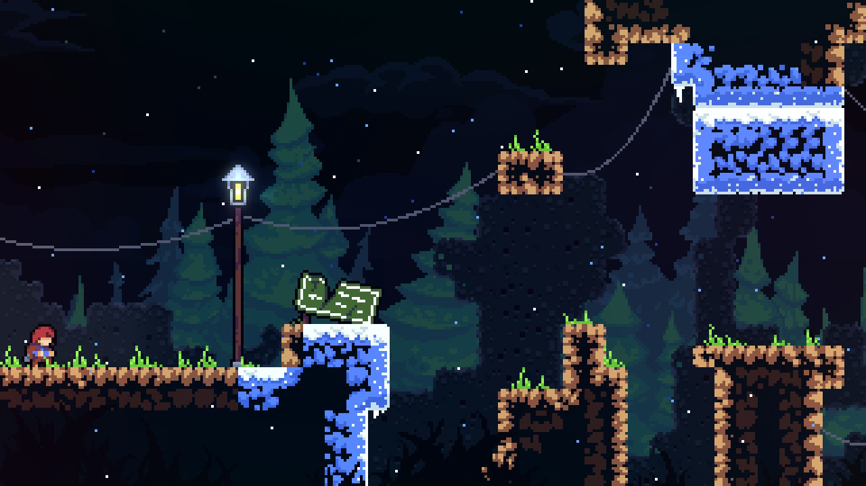
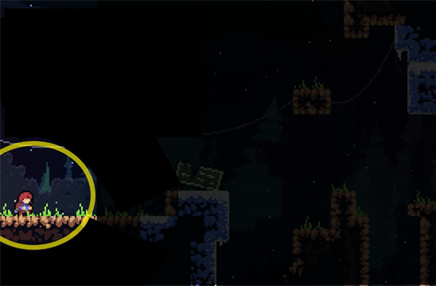
Features
Limited Vision (V1) :
The character is holding a torch in a dark cave which would result in only a small circle of vision around the character leaving the rest of the level black.
https://tinyurl.com/y74s3akp

Slide 6

Features
Limited Vision (V2) :
The character gains the ability to see invisible platforms and structures or gains the power of night vision in a dark and mysterious cave but can only use this ability while standing still. This means the player would switch between being able to see the platforms and being able to move the character.
https://tinyurl.com/y74s3akp

Slide 7

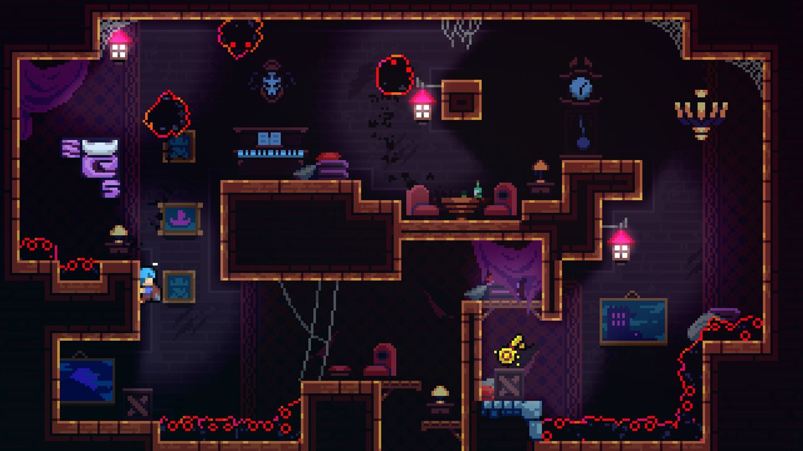
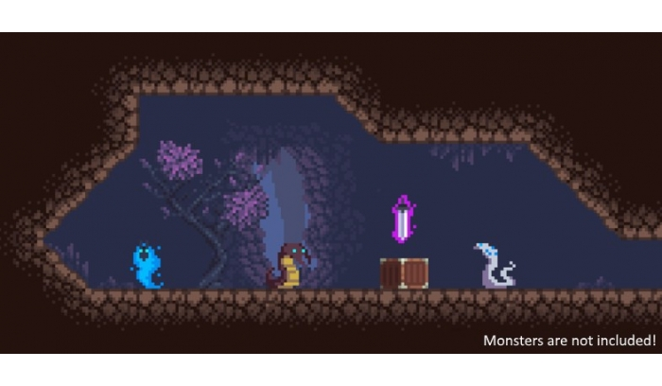
Game Design
https://tinyurl.com/yc8ftkjq
https://tinyurl.com/y9favjzr
https://tinyurl.com/y8y73pky

Slide 8
Teams
Art
Bring life to the game through a pixel art style
Programmers
Program the physics and movement of the game as well as create multiple mechanics for each level
Game Design / Gameplay
Team used to work together and brainstorm ideas for the games art direction and gameplay as well testing the game.

